Slide 1



Slide 2

Introduction to Machine Learning in Healthcare
Model Evaluation and Optimization
José Maria Moreira
jose.maria.moreira@luzsaude.pt

Slide 3

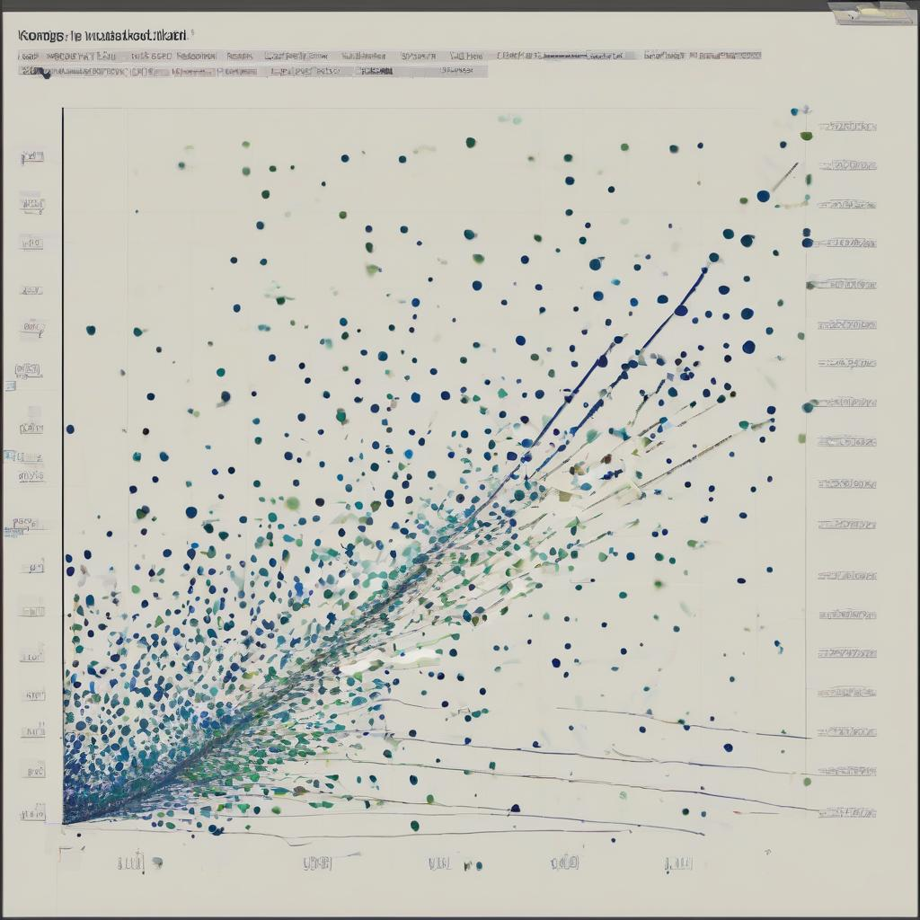


01
02
Model Evaluation Metrics for Classification
Model Evaluation Metrics for Regression
Content
03
04
Train-Test Split and Cross-Validation
Model Tuning and Optimization

Slide 4
RELEVANCE TO MEDICINE
Resource Allocation
Patient Safety
Accuracy and Reliability of Diagnoses
Personalized Medicine

Slide 5
KEY TERMS AND CONCEPTS
Classification
Regression
accuracy, precision, recall, F1 score, RMSE, MAE, etc.
Train-Test Split
Hyperparameters

Slide 6
LEARNING OBJECTIVES

Slide 7

MODEL EVALUATION METRICS FOR CLASSIFICATION
01

Slide 8
INTRODUCTION TO MODEL EVALUATION METRICS
Collect data
Clean Data
Prepare Data
Train Model
Evaluate Model
Monitor, collect and evaluate data
Deploy to production
Generate Dataset
Deploy the Model
Train the Model
Image from: What is a Machine Learning Pipeline? - Datatron

Slide 9
Classification model
MODEL OUTPUT
Data
Model
Prediction
Ground truth

Slide 10
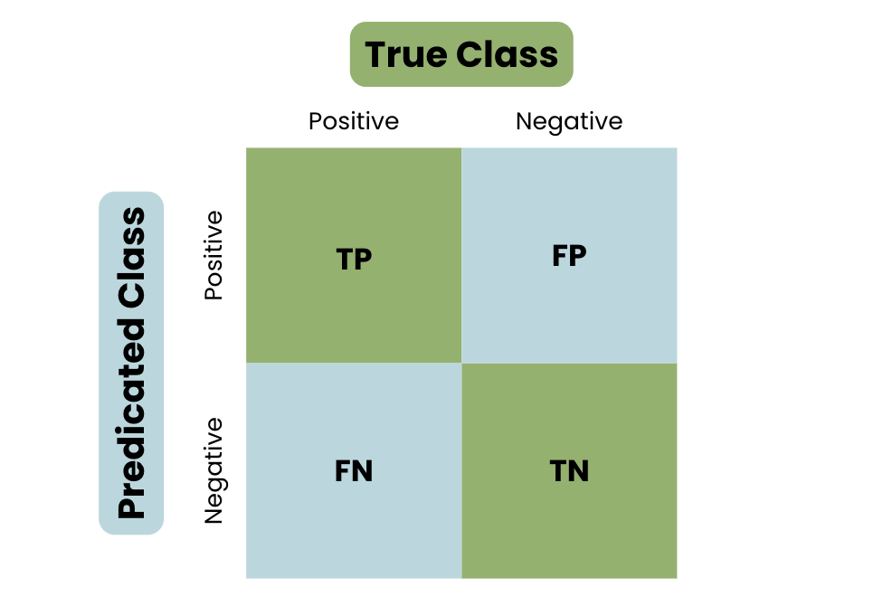
CONFUSION MATRIX
Prediction
9
3
Ground truth
4
9
Image from: What is A Confusion Matrix in Machine Learning? The Model Evaluation Tool Explained | DataCamp

Slide 11
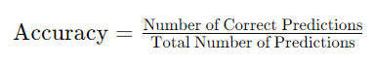
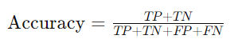
ACCURACY
measures the proportion of true results (both true positives and true negatives) among the total number of cases examined

Slide 12

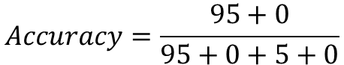
Main limitation
ACCURACY
Class imbalance
95
5
$$Accuracy=\frac{95+0}{95+0+5+0}$$
$$=0.95$$
0
0
Notes:
Doesn't Differentiate Error Types: Accuracy treats all errors equally, but in many medical applications, false negatives might be more critical than false positives (e.g., missing a cancer diagnosis).

Slide 13
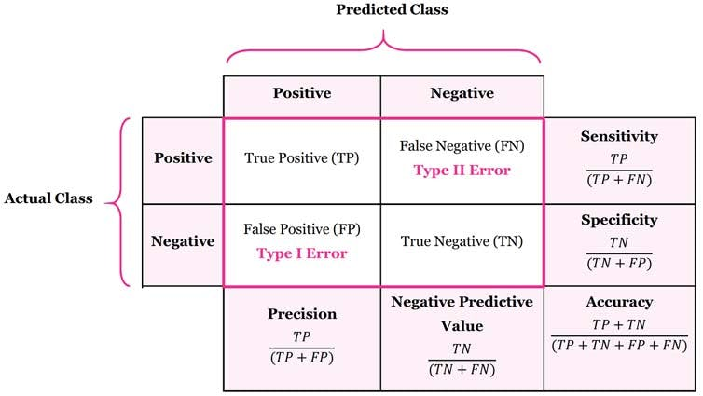
CONFUSION MATRIX
Image from: What is a Confusion Matrix? | Machine Learning Glossary | Encord | Encord

Slide 14
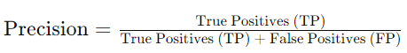
PRECISION
measures the accuracy of the positive predictions
Notes:
Relevance of Positive Predictions: Precision is crucial in scenarios where the cost of false positives is high.

Slide 15
Main limitation
PRECISION
Precision does not consider the false negatives, so it does not provide information about the ability of the model to identify all actual positives

Slide 16
Case study
PRECISION
Case Study Example
Consider a model designed to predict whether patients have a particular rare genetic disorder. High precision is crucial because:
False positives could lead to expensive and invasive follow-up tests.
Ensuring those diagnosed are highly likely to have the disorder can help in focusing medical resources effectively.
Notes:
Relevance of Positive Predictions: Precision is crucial in scenarios where the cost of false positives is high. For instance, in medical diagnostics, a high precision means that most of the patients diagnosed with the disease by the model indeed have the disease, reducing unnecessary treatments or further tests.

Slide 17
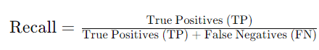
RECALL (SENSITIVITY)
quantifies the ability of the model to find all relevant cases within a dataset
Notes:
Identifying All Positive Cases: Recall is crucial in medical applications where it is important to identify all patients with a certain condition. High recall ensures that most of the actual positive cases are detected by the model.
Balancing with Precision: Recall is often considered alongside precision to provide a balanced view of the model's performance. High recall with low precision might indicate that the model is predicting many false positives, while high precision with low recall might indicate that the model is missing many actual positive cases.

Slide 18
Main limitation
RECALL (SENSITIVITY)
Recall does not consider the false positives, so it doesn't provide information about the accuracy of the positive predictions
Notes:
Disease Screening: Recall is critical in screening programs where it is essential to identify as many cases as possible, even at the expense of some false positives.
Early Disease Detection: Ensuring high recall in models used for early disease detection helps in capturing as many true cases as possible, facilitating timely intervention.
Monitoring Chronic Conditions: Recall is important in models used to monitor patients with chronic conditions to ensure that all instances of deterioration are identified.

Slide 19
Case study
RECALL (SENSITIVITY)
Case Study Example
Consider a model designed to predict whether patients have a highly infectious disease. High recall is crucial because:
Missing actual cases (false negatives) could result in the spread of the disease.
Early identification of all infected individuals allows for prompt isolation and treatment to prevent further transmission.

Slide 20
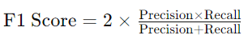
F1 SCORE
is the harmonic mean of precision and recall
Notes:
Balancing Precision and Recall: The F1 score is useful in scenarios where you need to balance the trade-off between precision and recall, especially when dealing with imbalanced classes.
Single Metric for Performance: Provides a single, comprehensive metric that summarizes the performance of the model, which is easier to interpret compared to looking at precision and recall separately.

Slide 21
Main limitation
F1 SCORE
Interpretability
Class Imbalance Sensitivity
Notes:
Interpretability: The F1 score combines precision and recall into a single number, which can sometimes obscure the individual contributions of precision and recall.
Class Imbalance Sensitivity: While the F1 score balances precision and recall, it may still be less informative in extreme cases of class imbalance, where other metrics like ROC-AUC might be more appropriate.

Slide 22
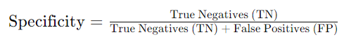
True Negative Rate (TNR)
SPECIFICITY
quantifies the ability of the model to correctly identify negative cases
Notes:
Accuracy of Negative Predictions: Specificity is crucial in scenarios where it is important to correctly identify patients who do not have a condition. High specificity means the model is good at avoiding false positives.
Balancing with Sensitivity: Specificity is often considered alongside sensitivity (recall) to provide a balanced view of the model's performance. High specificity with low sensitivity might indicate that the model is too conservative in predicting positives, while high sensitivity with low specificity might indicate that the model is too liberal, resulting in many false positives.

Slide 23
Main limitation
SPECIFICITY
Specificity does not consider the false negatives, so it doesn't provide information about the model's ability to identify all actual positive instances
Notes:
Diagnostic Tests: Specificity is important in evaluating diagnostic tests where false positives can lead to unnecessary treatments or anxiety.
Screening Programs: In medical screening programs, high specificity ensures that those identified as not at-risk are correctly classified, reducing unnecessary follow-up tests.
Predictive Models for Common Conditions: For conditions that are common, specificity helps ensure that the majority of negative predictions are accurate, avoiding unnecessary medical interventions.

Slide 24
True Negative Rate (TNR)
SPECIFICITY
Case Study Example
Consider a model designed to screen for a non-life-threatening condition that has a simple but expensive treatment. High specificity is crucial because:
False positives could lead to unnecessary and costly treatments.
Ensuring that patients who do not need the treatment are not incorrectly identified as needing it helps in managing healthcare costs and resources effectively.

Slide 25
ROC CURVE
used to evaluate the performance of a binary classification model
trade-off between sensitivity (true positive rate) and 1-specificity (false positive rate) at various threshold settings
helps in visualizing the ability of the classifier to distinguish between positive and negative instances

Slide 26
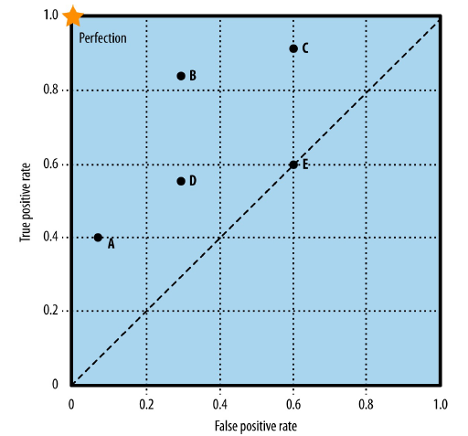
ROC CURVE
Only predicting positives
Random guessing
Never predicting positives

Slide 27
ROC CURVE
Instance | True Label | Prediction Score
1 | P | 0,99
2 | P | 0,98
3 | N | 0,96
4 | P | 0,90
5 | N | 0,88
6 | P | 0,87
7 | P | 0,85
8 | P | 0,84
9 | N | 0,80
10 | P | 0,75
11 | N | 0,74
12 | P | 0,71
13 | P | 0,65
0 | 0
100 | 100
1 | 0
99 | 100
2 | 0
98 | 100
2 | 1
98 | 99
...
Threshold | TP | FP | TN | FN | TPR | FPR
0,99 | 1 | 0 | 100 | 99 | 0,01 | 0
0,98 | 2 | 0 | 100 | 98 | 0,02 | 0
0,96 | 2 | 1 | 99 | 98 | 0,02 | 0,01
... | ... | ... | ... | ... | ... | ...
0,65 | 8 | 4 | 96 | 92 | 0,04 | 0,08
8 | 4
92 | 96

Slide 28
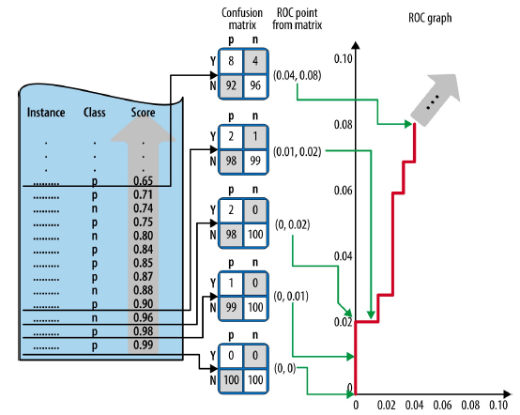
ROC CURVE

Slide 29
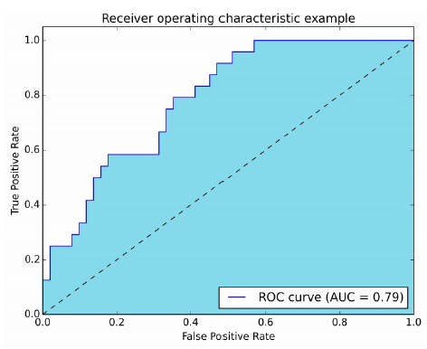
ROC CURVE
http://www.navan.name/roc/
Notes:
The area under the ROC curve (AUC) provides a single metric to evaluate the model's overall performance. AUC ranges from 0 to 1, with higher values indicating better performance.

Slide 30
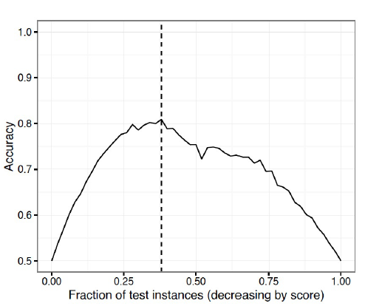
ACCURACY

Slide 31
Practical Application in Medicine
AUC (AREA UNDER THE ROC CURVE)
Evaluating Diagnostic Tests: A higher AUC indicates better performance in distinguishing between patients with and without a condition.
Model Comparison
Threshold Selection

Slide 32
PRECISION-RECALL CURVE
Explanation and interpretation

Slide 33
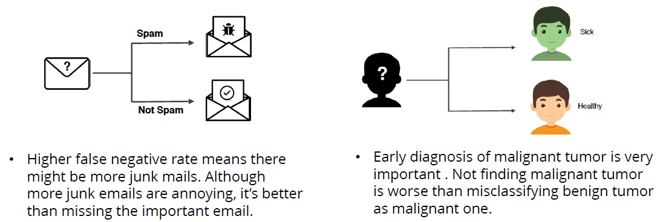
DISCUSSION

Slide 34
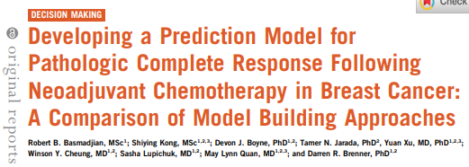
CASE-STUDY
https://doi.org/10.1200/CCI.21.00055

Slide 35
EXERCISE
notebook

Slide 36
COMMON PITFALLS
Misinterpretations and limitations of metrics

Slide 37
METRIC SELECTION
Some considerations when selecting the right metric for the classification task:
Binary vs. Multiclass Classification
Imbalanced Classes
Objective of the Model (minimizing false positives or negatives)
Threshold-Independent or -Dependent Metrics
Interpretability
Clinical Utility
Notes:
Disease Screening:
Objective: Detect as many cases as possible (high recall).
Metric: Recall (Sensitivity) is crucial. Precision may be less important if follow-up tests can confirm positive cases.
Diagnostic Testing:
Objective: Ensure that positive diagnoses are accurate to avoid unnecessary treatment (high precision).
Metric: Precision is crucial. Recall is also important, but the focus might be on avoiding false positives.
Predictive Modeling for Rare Diseases:
Objective: Balance between identifying rare cases and avoiding false alarms.
Metric: F1 Score provides a balance between precision and recall. AUC-ROC can also be informative to understand the model's performance across different thresholds.
In medicine, this often means balancing the need to identify true cases (high recall) with the need to avoid false positives (high precision). Metrics like the F1 score and AUC-ROC provide balanced and comprehensive evaluations of model performance. By considering the nature of the problem, clinical relevance, and ethical implications, the most appropriate metric can be selected to ensure the model meets the desired goals and constraints.

Slide 38
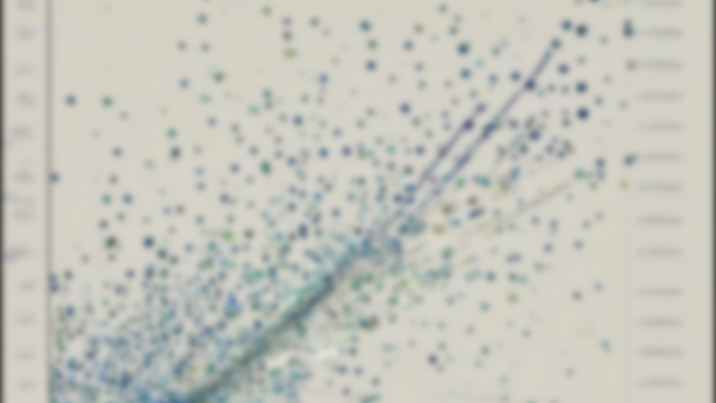
MODEL EVALUATION METRICS FOR REGRESSION
02

Slide 39
INTRODUCTION TO MODEL EVALUATION METRICS
Collect data
Clean Data
Prepare Data
Train Model
Evaluate Model
Monitor, collect and evaluate data
Deploy to production
Generate Dataset
Deploy the Model
Train the Model
Image from: What is a Machine Learning Pipeline? - Datatron

Slide 40
Regression model
MODEL OUTPUT
Data
Model
Prediction
Ground truth

Slide 41
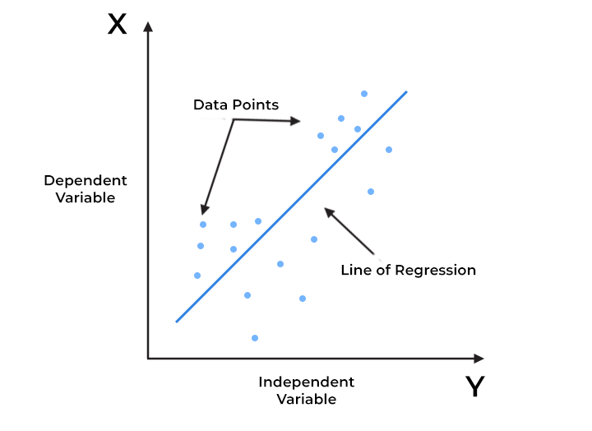
Regression model
MODEL OUTPUT
Data
Model
Image from: https://www.spiceworks.com/tech/artificial-intelligence/articles/what-is-linear-regression/
Notes:
Inventa regressão no quadro

Slide 42
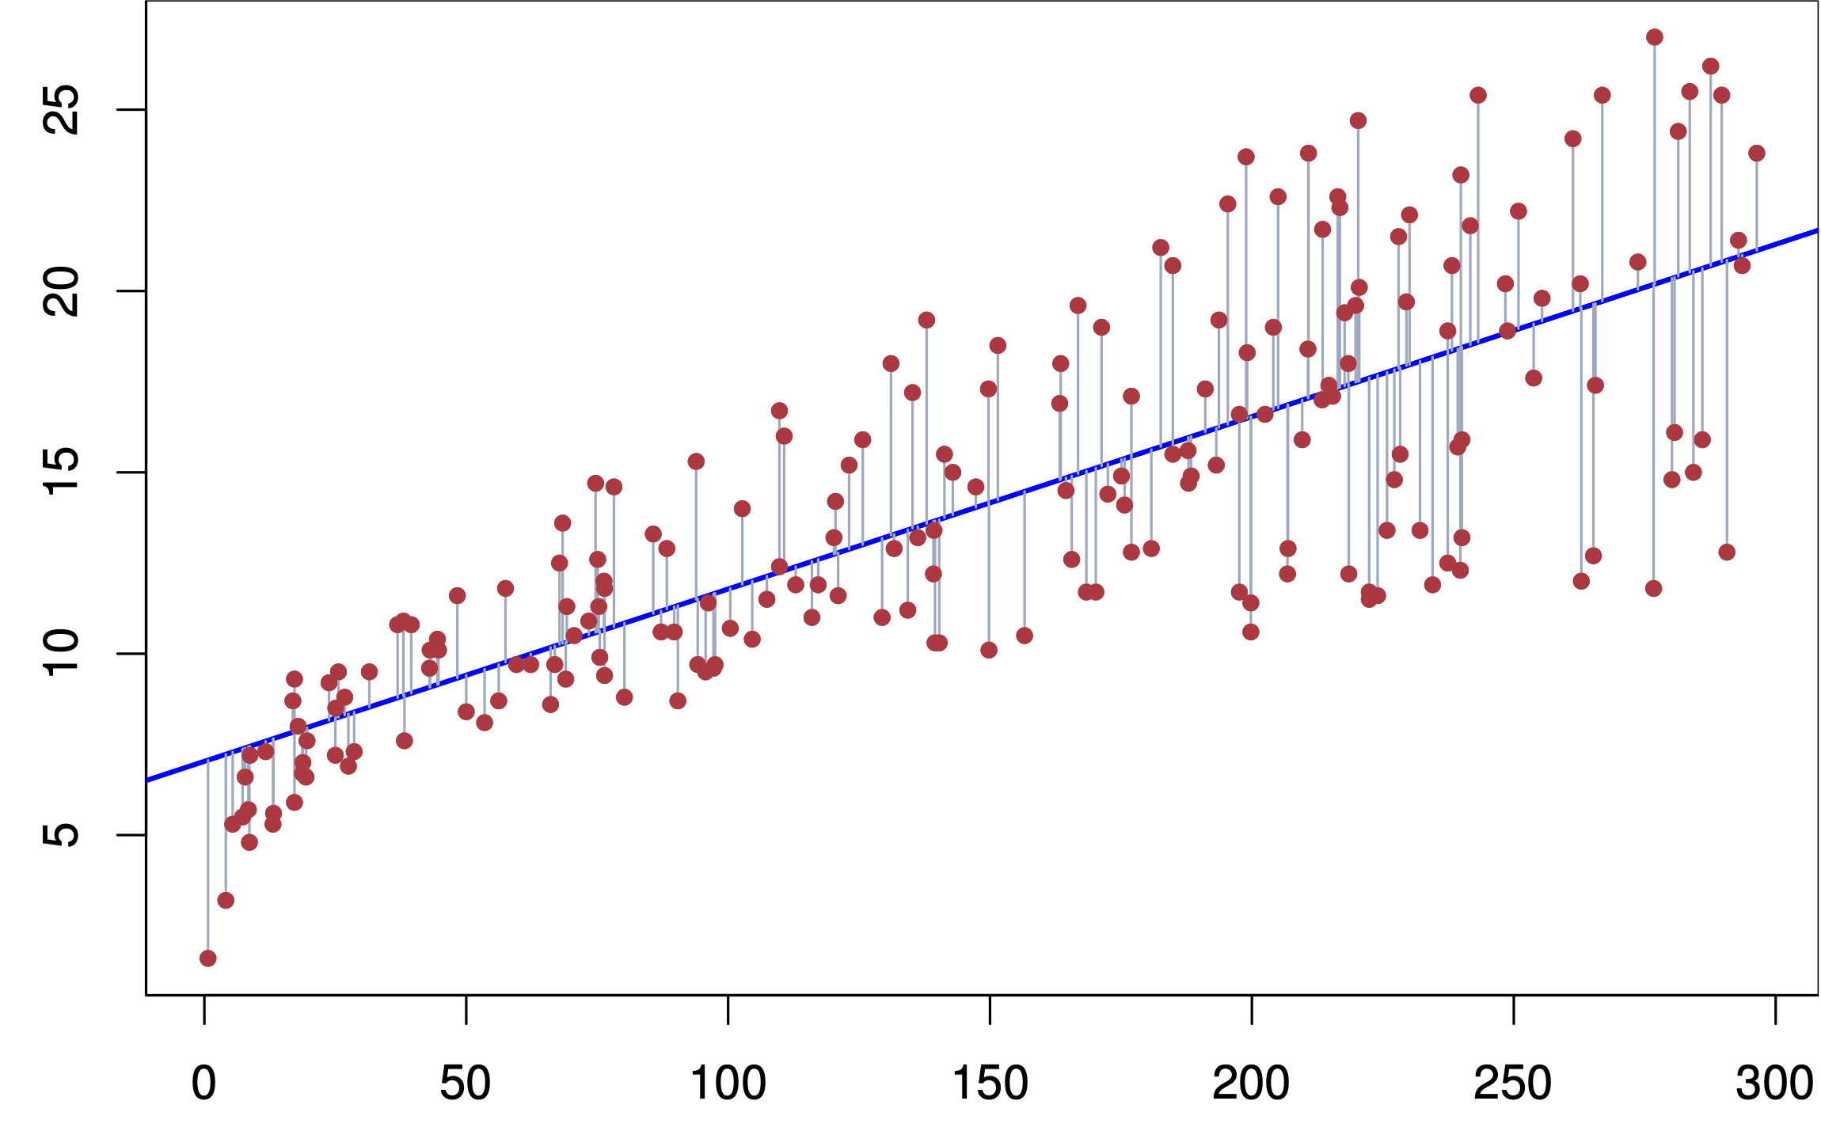
Metrics
MODEL OUTPUT
Image from: https://web.stanford.edu/class/stats202/notes/Linear-regression/Simple-linear-regression.html

Slide 43
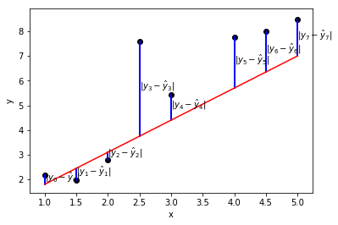
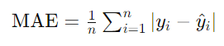
MEAN ABSOLUTE ERROR (MAE)
measures the average magnitude of errors between predicted and actual values
Image from: https://jmlb.github.io/flashcards/2018/07/01/mae_vs_rmse/
Notes:
Interpretation
MAE = 0: Perfect model with no errors in prediction.
Higher MAE: Indicates larger average errors in prediction.

Slide 44
MEAN SQUARED ERROR (MSE)
Importance
Interpretability: MAE is easy to understand and interpret, as it represents the average error in the same units as the target variable.
Robustness to Outliers: Unlike metrics such as Mean Squared Error (MSE), MAE is less sensitive to outliers because it does not square the error terms.
Limitations
Equal Weight to All Errors: MAE gives equal weight to all errors, regardless of their magnitude. This can be a limitation in cases where larger errors need to be penalized more.
Notes:
The average error provided by MAE is easy for clinicians to interpret and understand in the context of medical practice.

Slide 45
EXERCISE
1, 3, 5
0.5, 3,5, 5

Slide 46
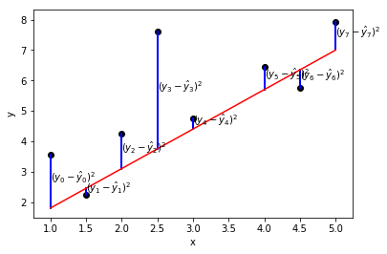
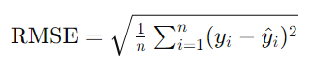
ROOT MEAN SQUARED ERROR (RMSE)
measures the square root of the average of the squared differences between predicted and actual values
Image from: https://jmlb.github.io/flashcards/2018/07/01/mae_vs_rmse/

Slide 47
ROOT MEAN SQUARED ERROR (RMSE)
Importance
Sensitive to Large Errors: RMSE is more sensitive to large errors compared to MAE because the errors are squared before averaging. This means that RMSE can be particularly useful when large errors are undesirable.
Limitations
Sensitivity to Outliers: Because RMSE squares the error terms, it can be disproportionately influenced by outliers. Large errors will have a greater impact on RMSE.
Comparability: RMSE values are context-specific and can only be used to compare models on the same dataset or problem.

Slide 48
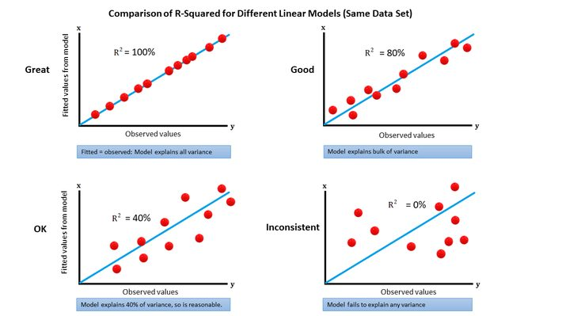
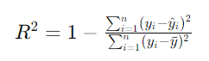
R-SQUARED (R2)
statistical measure that represents the proportion of the variance for a dependent variable that's explained by an independent variable or variables in a regression model
Image from: https://www.datasciencecentral.com/r-squared-in-one-picture/
Notes:
R² = 1: The model explains all the variability of the response data around its mean. Perfect fit.
R² = 0: The model explains none of the variability of the response data around its mean. No explanatory power.
0 < R² < 1: The model explains a portion of the variability of the response data around its mean.

Slide 49
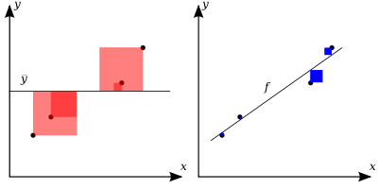
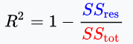
R-SQUARED (R2)
Image from: https://en.wikipedia.org/wiki/Coefficient_of_determination#/media/File:Coefficient_of_Determination.svg
Notes:
sum of squares of residuals
total sum of squares (proportional to the variance of the data)

Slide 50
R-SQUARED (R2)
Importance
Goodness of Fit: R² is a key indicator of the goodness of fit of a model. It shows how well the model explains the variability in the dependent variable.
Model Comparison: R² can be used to compare the explanatory power of different models for the same dataset.
Limitations
Does Not Indicate Causation: A high R² value does not imply that the model variables are causally related to the dependent variable.
Not Suitable for Non-Linear Models: R² is primarily used for linear regression models and may not be appropriate for evaluating non-linear models.

Slide 51
ADJUSTED R-SQUARED
Definition and importance

Slide 52
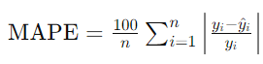
MEAN ABSOLUTE PERCENTAGE ERROR (MAPE)
expresses the average absolute error between the predicted and actual values as a percentage of the actual values
Notes:
provides a normalized measure of error, making it easier to interpret and compare across different datasets

Slide 53
MEAN ABSOLUTE PERCENTAGE ERROR (MAPE)
Importance
Interpretability: MAPE is easy to understand and interpret, as it represents the error as a percentage of the actual values.
Normalization: MAPE provides a normalized measure of error, making it useful for comparing model performance across different datasets and scales.
Limitations
Division by Zero: MAPE is undefined if any actual value (yi​) is zero, as this would involve division by zero.
Sensitivity to Small Values: MAPE can be excessively high if the actual values are very small, as small differences between predicted and actual values result in large percentage errors.

Slide 54
MEDIAN ABSOLUTE ERROR

Slide 55
CASE-STUDY
Application of regression metrics in predicting patient outcomes

Slide 56
COMMON PITFALLS
Misinterpretations and limitations of regression metrics

Slide 57
METRIC SELECTION

Slide 58
EXTRA – SURVIVAL ANALYSIS

Slide 59

TRAIN-TEST SPLIT AND CROSS VALIDATION
03

Slide 60
INTRODUCTION TO TRAIN-TEST SPLIT
Models should be robust, generalizable, and capable of performing well on unseen data

Slide 61
TRAIN-TEST SPLIT
Data set

Slide 62
RANDOM SPLIT
Training set
Test set

Slide 63
STRATIFIED SPLIT
Training set
Test set

Slide 64
OVERFITTING AND UNDERFITTING
Notes:
How can we evaluate where to set the boundary, for a good model to generalize to unseen data

Slide 65
OVERFITTING AND UNDERFITTING
Test

Slide 66
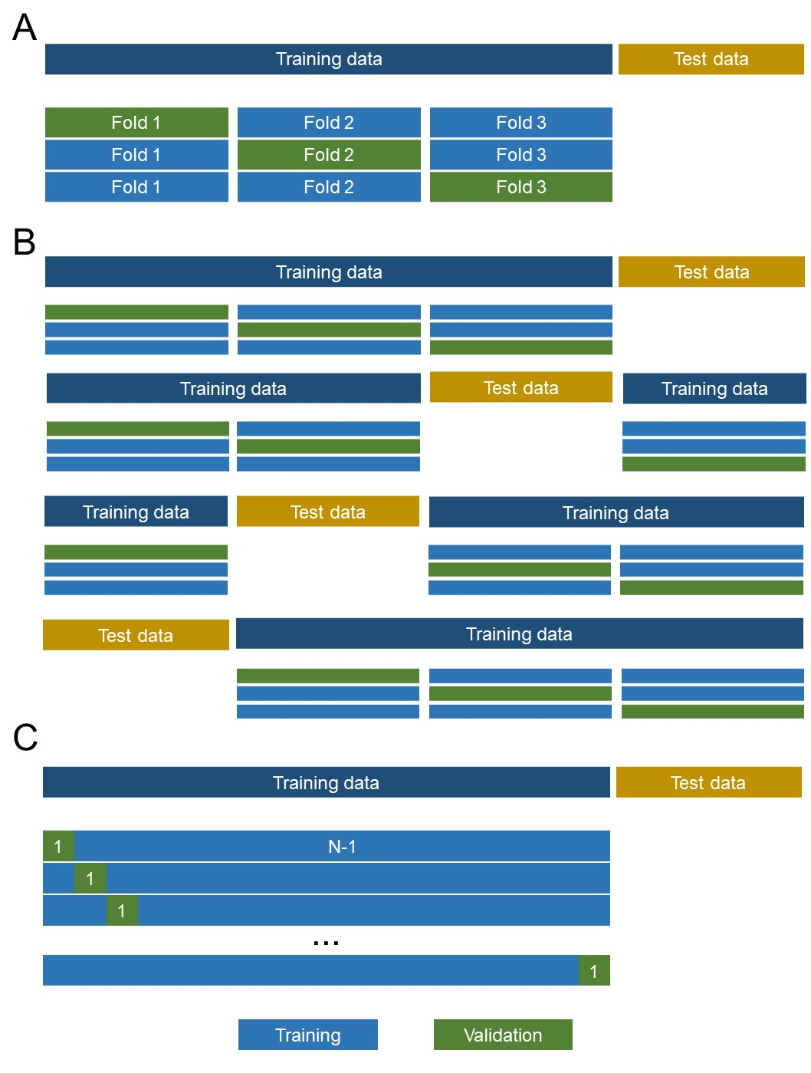
K-FOLD CROSS-VALIDATION

Slide 67
K-FOLD CROSS-VALIDATION

Slide 68
LEAVE-ONE-OUT CROSS-VALIDATION

Slide 69
STRATIFIED K-FOLD CROSS-VALIDATION

Slide 70
(for medical data with temporal component)
TIME-SERIES SPLIT
Data set
time
Training set
Test set
Notes:
Disadvantages:
Temporal Dependency: Does not account for temporal dependencies beyond the split point, potentially leading to misleading performance estimates.

Slide 71
(for medical data with temporal component)
TIME-SERIES SPLIT – SLIDING WINDOW
Data set
Split 1
Split 2
Split 3
time
Training set
Test set
Notes:
Advantages:
Multiple Evaluations: Provides multiple training and testing phases, leading to a more robust performance estimate.
Disadvantages:
Fixed Window Size: Choosing an appropriate window size can be challenging and may not capture long-term dependencies.

Slide 72
(for medical data with temporal component)
TIME-SERIES SPLIT – EXPANDING WINDOW
Data set
Split 1
Split 2
Split 3
time
Training set
Test set
Notes:
Disadvantages:
Imbalance in Training Data: Initial models are trained on less data, which might lead to less stable performance estimates in early iterations.

Slide 73
EXERCISE

Slide 74
CROSS-VALIDATION METRICS
Interpreting results from cross-validation

Slide 75

MODEL TUNING AND OPTIMIZATION
04

Slide 76
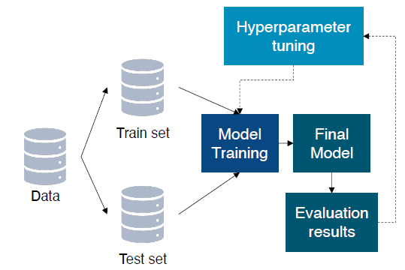
INTRODUCTION TO MODEL TUNING
Validation set

Slide 77
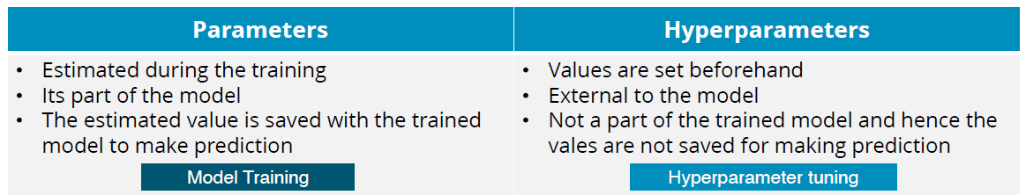
HYPERPARAMETERS AND PARAMETERS

Slide 78
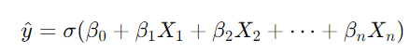
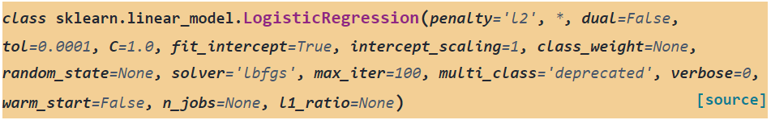
LOGISTIC REGRESSION
HYPERPARAMETERS AND PARAMETERS
Notes:
Log Loss
Hyperparameters:
C (or λ=1C\lambda = \frac{1}{C}λ=C1​): Controls regularization strength.
Penalty: Type of regularization ('l1', 'l2', or 'elasticnet').
Solver: Optimization algorithm.
max_iter: Maximum number of iterations.
tol: Tolerance for stopping criteria.
class_weight: Weights for handling class imbalance.

Slide 79
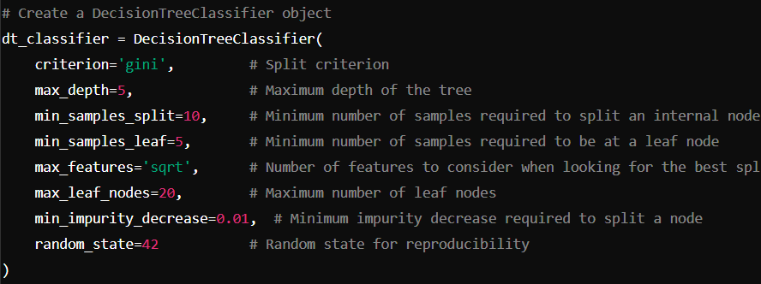
DECISION TREE
HYPERPARAMETERS AND PARAMETERS
Notes:
Parameters in Decision Trees
Node Splits:
Leaf Nodes:
Apresentar arvore

Slide 80
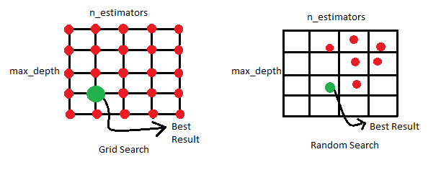
GRID SEARCH VS. RANDOM SEARCH

Slide 81
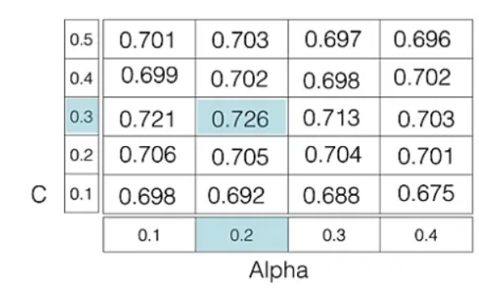
GRID SEARCH VS. RANDOM SEARCH

Slide 82
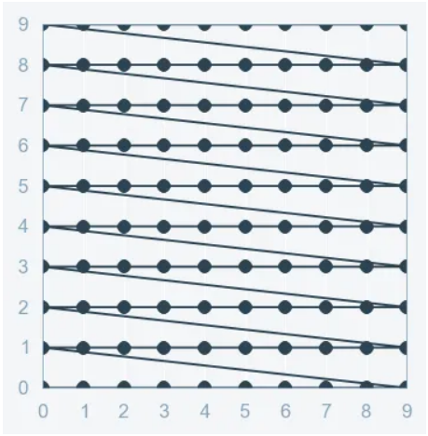
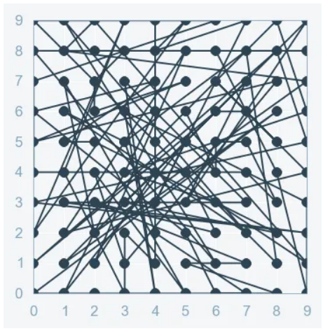
GRID SEARCH VS. RANDOM SEARCH
GRID SEARCH
RANDOM SEARCH

Slide 83
RANDOM SEARCH

Slide 84
BAYESIAN OPTIMIZATION

Slide 85
EXERCISE
GRID SEARCH

Slide 86
BREAK

Slide 87
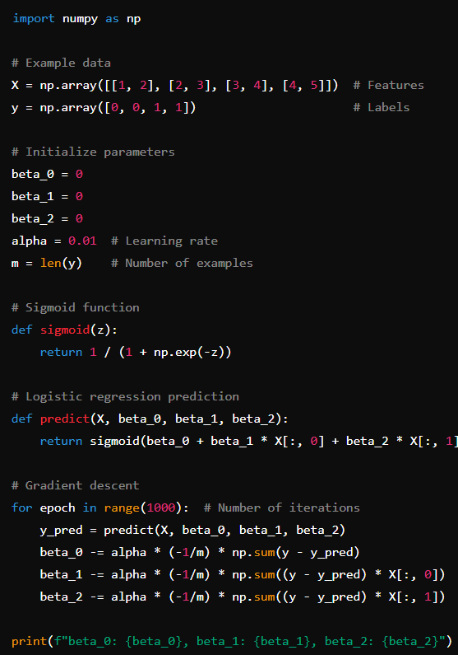
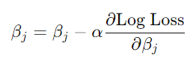
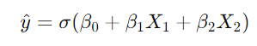
LOGISTIC REGRESSION
GRADIENT DESCENT UPDATE RULE

Slide 88
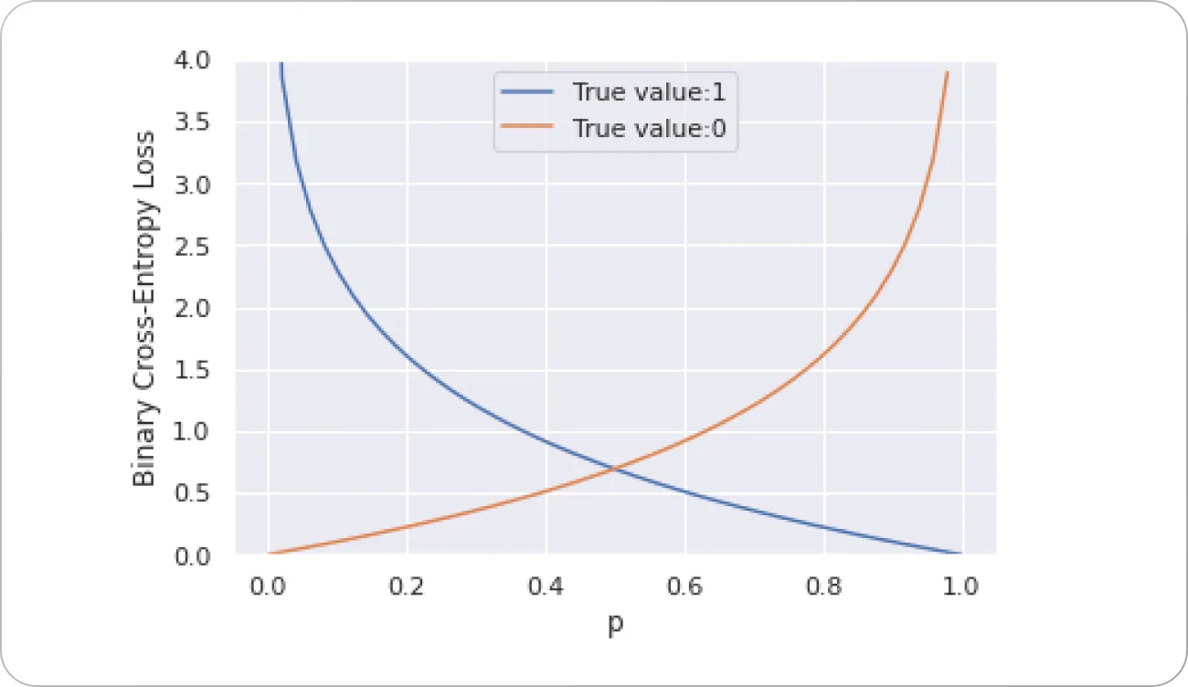
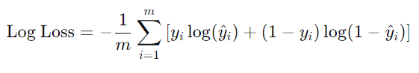
LOG LOSS

Slide 89
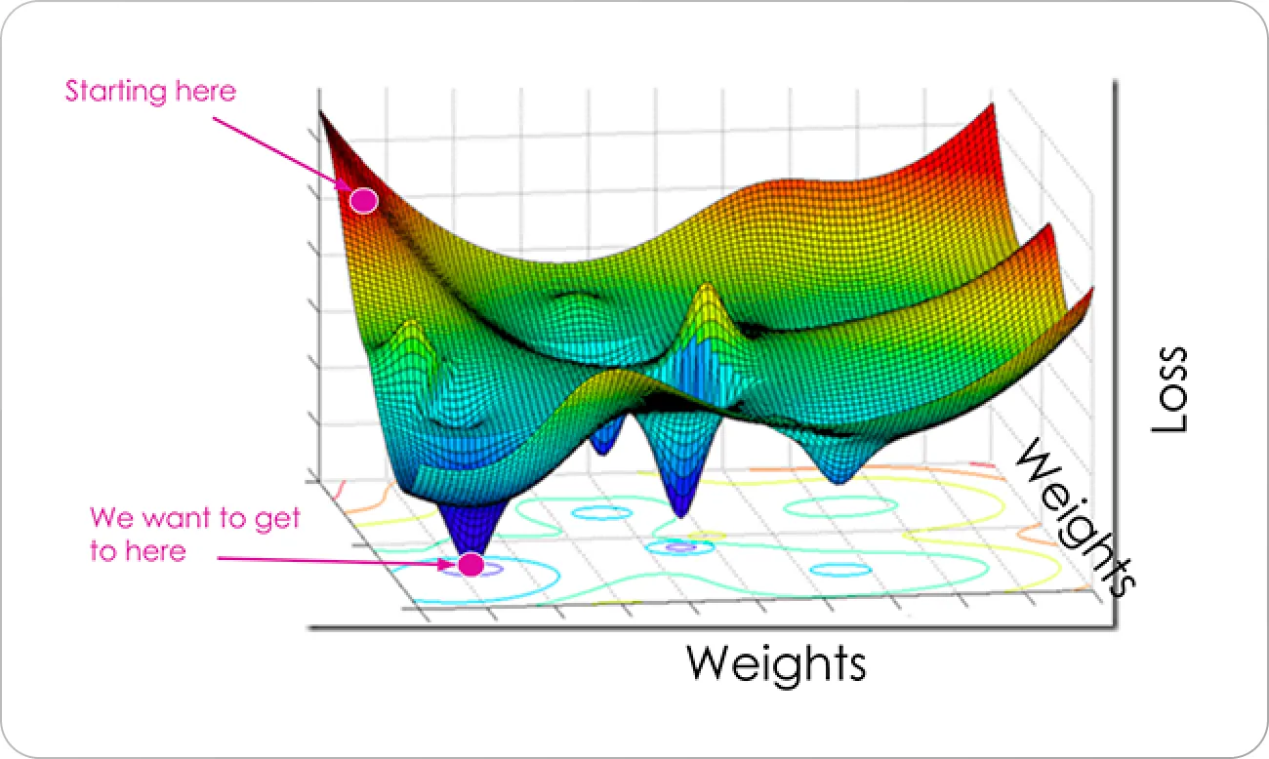
OPTIMIZATION

Slide 90
EXERCISE
GRADIENT DESCENT

Slide 91
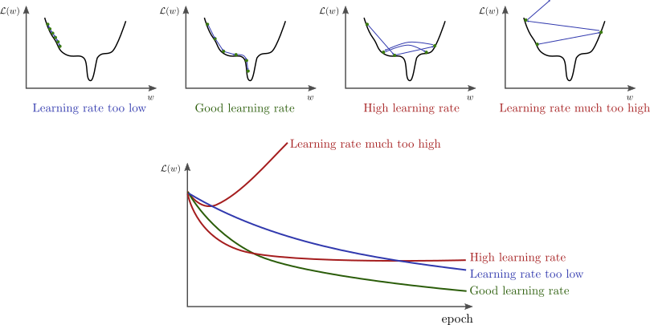
LEARNING RATE
From https://www.bdhammel.com/learning-rates/

Slide 92
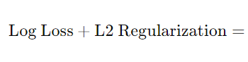
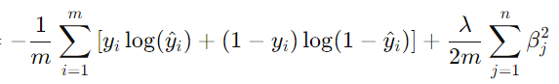
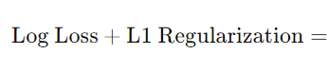
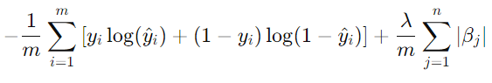
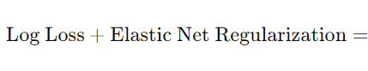

REGULARIZATION TECHNIQUES

Slide 93

EARLY STOPPING
From https://paperswithcode.com/method/early-stopping

Slide 94
MODEL SELECTION
Criteria for choosing the best model

Slide 95
ENSEMBLE MODELS
Bagging, boosting, and stacking

Slide 96
ADVANCED OPTIMIZATION TECHNIQUES
Genetic algorithms, simulated annealing

Slide 97
INTERPRETABILITY AND EXPLAINABILITY

Slide 98


CONCLUSION

Slide 99

MODEL MONITORING
From https://martinfowler.com/articles/cd4ml.html
Notes:
Data drift: The incoming data’s statistical attributes change over time.
Concept drift: The predictive relationship changes between your input features and the target label.

Slide 100
FURTHER READING

Slide 101
THANK YOU
jose.maria.moreira@luzsaude.pt

Slide 102



Slide 103


Digital
Saúde

Slide 104
Pessoas
Finanças

Slide 105



